Slide 1
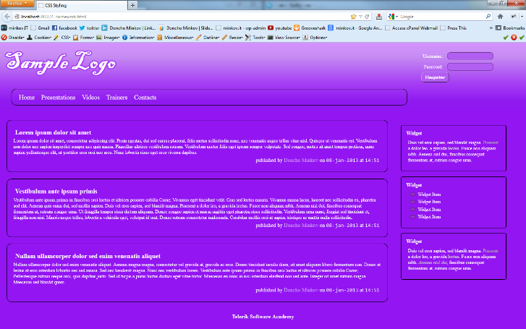
Homework
Implement the following using LESS
Use the HTML code from homework.html
Create the LESS easy to change (backgrounds, fonts)
Use mixins for clears, gradients)

